Slide 1


Slide 2

C1W3 Slides

Slide 3
Define data and establish baseline
Why is data definition hard?

Slide 4
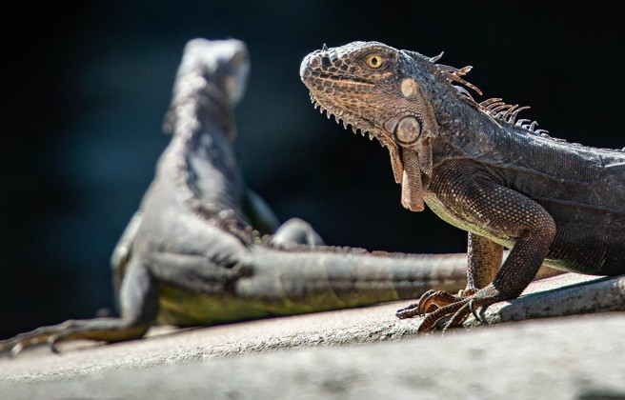

Iguana detection example
Labeling instructions: "Use bounding boxes to indicate the position of iguanas"

Slide 5



Phone defect detection

Slide 6


Data stage
Scoping
Data
Modeling
Deployment
Define data and establish baseline
Label and organize data
Select and train model
Perform error analysis
Deploy in production
Monitor & maintain system
Define project

Slide 7
Define data and establish baseline
More label ambiguity examples

Slide 8
Speech recognition example
"Um, nearest gas station"
"Umm, nearest gas station" ”Nearest gas station [unintelligible]"

Slide 9
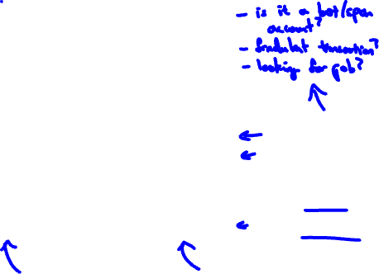
User ID merge example
Job Board (website)
Resume chat (app)
nova@deeplearning.ai Nova
Ng
1234 Jane Way CA
94304
Email
First Name Last Name
Address State Zip
nova@chatapp.com
Nova Ng
?
?
94304
1 if same
0 if different

Slide 10


Data definition questions
What is the input x?
Lightning? Contrast? Resolution?
What features need to be included?
What is the target label y?
How can we ensure labelers give consistent labels?

Slide 11
Define data and establish baseline
Major types of data problems

Slide 12


Major types of data problems
Unstructured Structured
Manufacturing visual inspection from 100 training examples | Housing price prediction based on square footage, etc. from 50 training examples
Speech recognition from 50 million training examples | Online shopping recommendations for 1 million users
Small data
Clean labels are critical.
Big data
Emphasis on data process.
Humans can label data. Data augmentation.
Harder to obtain more data.

Slide 13
Unstructured vs. structured data
Unstructured data
May or may not have huge collection of unlabeled examples x.
Humans can label more data.
Data augmentation more likely to be helpful.
Structured data
May be more difficult to obtain more data.
Human labeling may not be possible (with some exceptions).

Slide 14
Small data vs. big data
Small data
Clean labels are critical.
Can manually look through dataset and fix labels.
Can get all the labelers to talk to each other.
Big data
! Emphasis data process.

Slide 15

Define data and establish baseline
Small data and label consistency

Slide 16


Why label consistency is important
Speed (rpm)
Speed (rpm)
Speed (rpm)
Voltage
Voltage
Voltage
•
•
Small data
Clean (consistent) labels
Small data
Noisy labels
Big data
Noisy labels

Slide 17
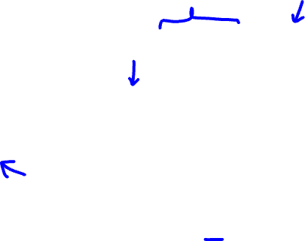



Phone defect example
Defect?
1
0
0.1
0.2 0.3 0.4
Scratch length (mm)
0.5
Defect?
1
0
0.1
0.2 0.3 0.4
Scratch length (mm)
0.5

Slide 18
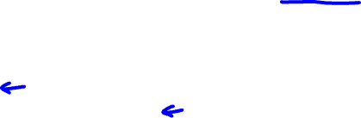
Big data problems can have small data challenges too
Problems with a large dataset but where there’s a long tail of rare events in the input will have small data challenges too.
Web search
Self-driving cars
Product recommendation systems

Slide 19
Define data and establish baseline
Improving label consistency

Slide 20
Improving label consistency
Have multiple labelers label same example.
When there is disagreement, have MLE, subject matter expert (SME) and/or labelers discuss definition of y to reach agreement.
If labelers believe that x doesn’t contain enough information, consider changing x.
Iterate until it is hard to significantly increase agreement.

Slide 21



Examples
! Standardize labels "Um, nearest gas station" "Umm, nearest gas station"
”Nearest gas station [unintelligible]”
"Um, nearest gas station"
! Merge classes
Scratch
Deep scratch
Shallow scratch

Slide 22






Have a class/label to capture uncertainty
! Defect: 0 or 1
Alternative: 0, Borderline, 1
! Unintelligible audio
“nearest go” “nearest grocery”
“nearest [unintelligible]”

Slide 23

Small data vs. big data (unstructured data)
Small data
Usually small number of labelers.
Can ask labelers to discuss specific labels.
Big data
Get to consistent definition with a small group.
Then send labeling instructions to labelers.
Can consider having multiple labelers label every example and using voting or consensus labels to increase accuracy.

Slide 24
Define data and establish baseline
Human level performance (HLP)

Slide 25
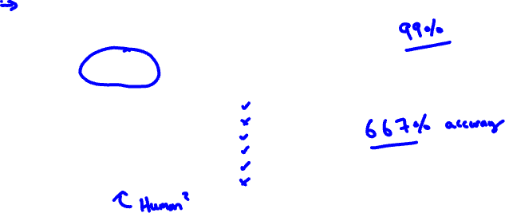
Why measure HLP?
Estimate Bayes error / irreducible error to help with error analysis and prioritization.
Ground Truth Label | Inspector
1 | 1
1 | 0
1 | 1
0 | 0
0 | 0
0 | 1

Slide 26
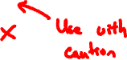
Other uses of HLP
! In academia, establish and beat a respectable benchmark to support publication.
!
Business or product owner asks for 99% accuracy. HLP helps establish a more reasonable target.
! “Prove” the ML system is superior to humans doing the job and thus the business or product owner should adopt it.

Slide 27
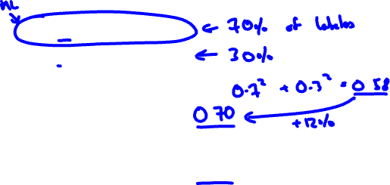
The problem with beating HLP as a “proof” of ML “superiority”
"Um... nearest gas station" "Um, nearest gas station"
Two random labelers agree:
ML agrees with humans:
The 12% better performance is not important for anything! This can also mask more significant errors ML may be making.

Slide 28
Define data and establish baseline
Raising HLP

Slide 29
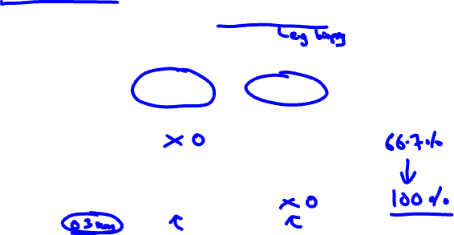
Raising HLP
When the ground truth label is externally defined, HLP gives an estimate for Bayes error / irreducible error.
But often ground truth is just another human label.
Scratch length (mm)
0.7
0.2
0.5
0.2
0.1
0.1
Ground Truth Label
Inspector
1 | 1
1 | 0
1 | 1
0 | 0
0 | 0
0 | 1

Slide 30
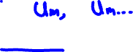
Raising HLP
When the label y comes from a human label, HLP << 100% may indicate ambiguous labeling instructions.
Improving label consistency will raise HLP.
This makes it harder for ML to beat HLP. But the more consistent labels will raise ML performance, which is ultimately likely to benefit the actual application performance.

Slide 31
HLP on structured data
Structured data problems are less likely to involve human labelers, thus HLP is less frequently used.
Some exceptions:
User ID merging: Same person?
Based on network traffic, is the computer hacked?
Is the transaction fraudulent?
Spam account? Bot?
From GPS, what is the mode of transportation – on foot, bike, car, bus?

Slide 32
Label and organize data
Obtaining data

Slide 33
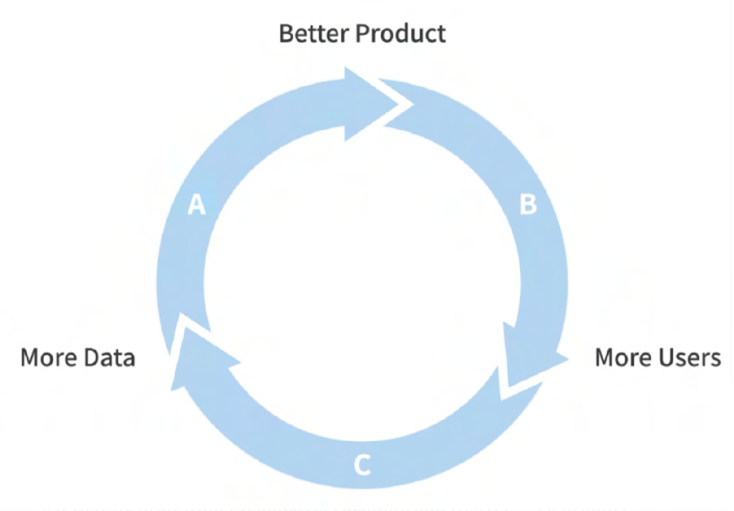
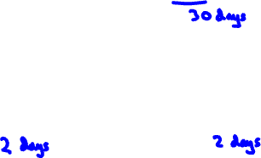

How long should you spend obtaining data?
Model +
! Get into this iteration loop as quickly possible.
Hyperparameters + Data
! Instead of asking: How long it would take to obtain m examples?
Ask: How much data can we obtain in k days.
! Exception: If you have worked on the problem before and from experience you know you need m examples.
Error analysis
Training

Slide 34

Inventory data
Brainstorm list of data sources (
speech recognition)
Source Amount
Cost
Time
0
14 days
7 days
1 day
Owned 100h
Crowdsourced – Reading 1000h Pay for labels 100h
Purchase data 1000h
$0
$10000
$6000
$10000
Other factors: Data quality, privacy, regulatory constraints

Slide 35


Labeling data
Options: In-house vs. outsourced vs. crowdsourced
Having MLEs label data is expensive. But doing this for just a few days is usually fine.
Who is qualified to label?
Speech recognition – any reasonably fluent speaker
Factory inspection, medical image diagnosis – SME (subject matter expert) Recommender systems – maybe impossible to label well
Don’t increase data by more than 10x at a time

Slide 36
Label and organize data
Data pipeline

Slide 37
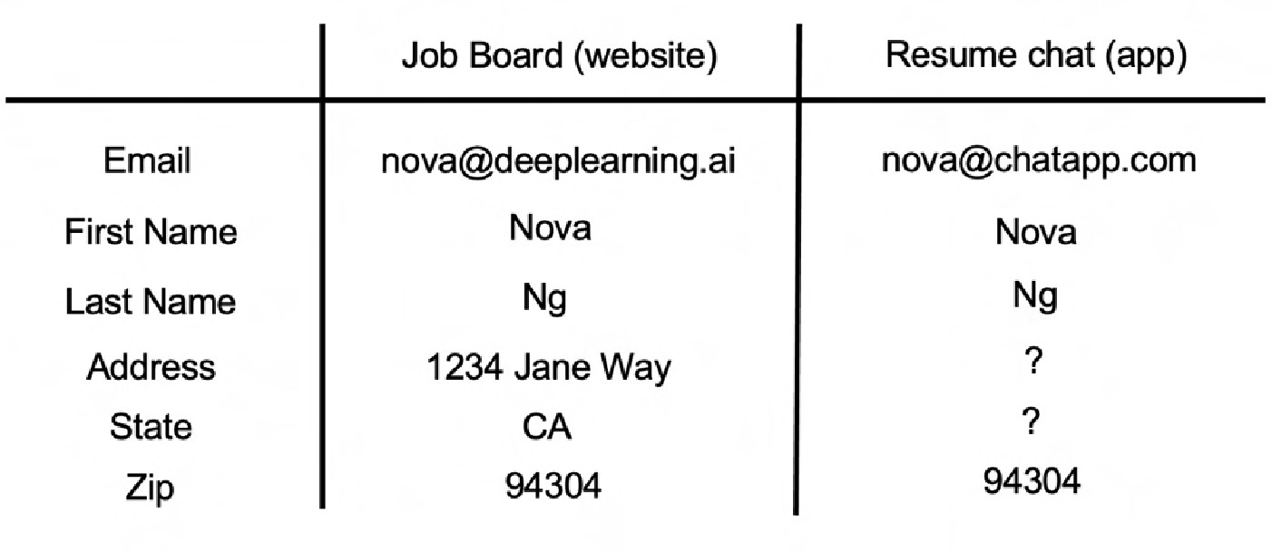
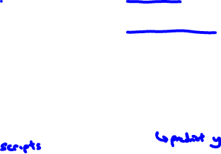

Data pipeline example
x = user info
y = looking for job
Raw data
Data cleaning
spam user ID merge cleanup
ML

Slide 38
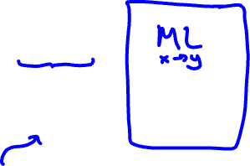
Data pipeline example
Data
Pre- processing s cripts
Development
Test set performance
New Data
Production
Replicate scripts
Product
How to replicate?

Slide 39
POC and Production phases
POC (proof-of-concept):
Goal is to decide if the application is workable and worth deploying.
Focus on getting the prototype to work!
It's ok if data pre-processing is manual. But take extensive notes/comments.
Production phase:
After project utility is established, use more sophisticated tools to make sure the data pipeline is replicable.
E.g., TensorFlow Transform, Apache Beam, Airflow,….

Slide 40
Label and organize data
Meta-data, data provenance and lineage

Slide 41
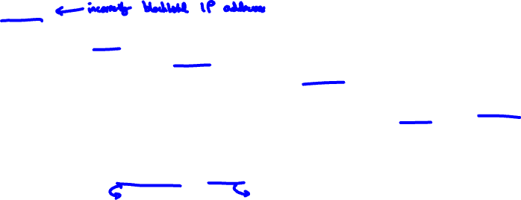

Data pipeline example
Task: Predict if someone is looking for a job. ( x = user data, y = looking for a job? )
Spam dataset
Anti-spam model
De-spammed
ML Code
user data
User data
Clean user data
ID merge data
Job search model
Predictions
ID merge model
ML Code
ML Code
Keep track of data provenance and lineage
where it comes from
sequence of steps

Slide 42
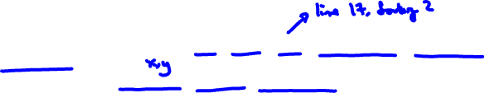

Meta-data
Examples:
Manufacturing visual inspection: Time, factory, line #, camera settings, phone model, inspector ID,….
Speech recognition: Device type, labeler ID, VAD model ID,.…
Useful for:
Error analysis. Spotting unexpected effects.
Keeping track of data provenance.

Slide 43
Label and organize data
Balanced train/dev/test splits

Slide 44
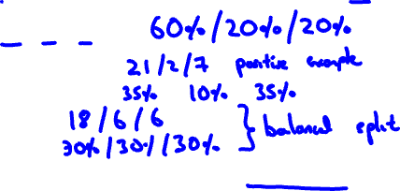
Balanced train/dev/test splits in small data problems
Visual inspection example: 100 examples, 30 positive (defective)
Train/dev/test:
Random split:
Want:
No need to worry about this with large datasets – a random split will be representative.

Slide 45
C1W3 Slides (Optional)
Scoping

Slide 46
Scoping (optional)
What is scoping?

Slide 47


Scoping
Data
Modeling
Deployment
Define data and establish baseline
Label and organize data
Select and train model
Perform error analysis
Deploy in production
Monitor & maintain system
Define project
Scoping example:
Ecommerce retailer looking to increase
sales
! Better recommender system Questions:
• Data Storage Model
Better search
Improve catalog data
Inventory management
Price optimization
What projects should we work on?
What are the metrics for success?
What are the resources (data, time,
! Define data
a. How much silence before & after clip?
b. Consistent Labels
Research/Academia ^{Algorithm/Model}
ML Model Code
Production Hyperparameters _{X → Y}
Data
! Decide on key metrics (accuracy, latency/throughput etc…)
! Decide to work on speech recognition for voice search
people) needed?

Slide 48
Scoping (optional)
Scoping process

Slide 49








Scoping process
What are the top 3 things you wish were working better?
Increase conversion
Reduce inventory
Increase margin (profit per item)
Identify a business problem (not an AI problem)
Brainstorm AI solutions
Assess the feasibility and value of potential solutions
Determine milestones
Budget for resources

Slide 50
Separating problem identification from solution
Problem Solution
Increase conversion
Search, recommendations
Reduce inventory
Demand prediction, marketing
Increase margin (profit per item)
Optimizing what to sell (e.g., merchandising), recommend bundles
What to achieve
How to achieve

Slide 51
Scoping (optional)
Diligence on feasibility and value

Slide 52
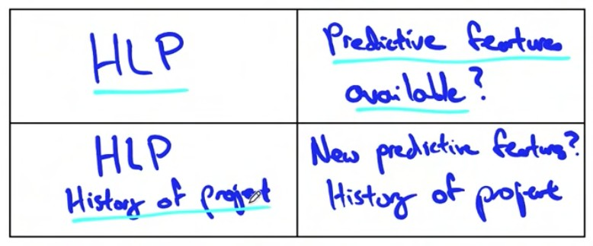
Feasibility: Is this project technically feasible?
Use external benchmark (literature, other company, competitor)
Unstructured (e.g., speech, images)
Structured
(e.g., transactions, records)
New
Existing
HLP: Can a human, given the same data, perform the task?

Slide 53
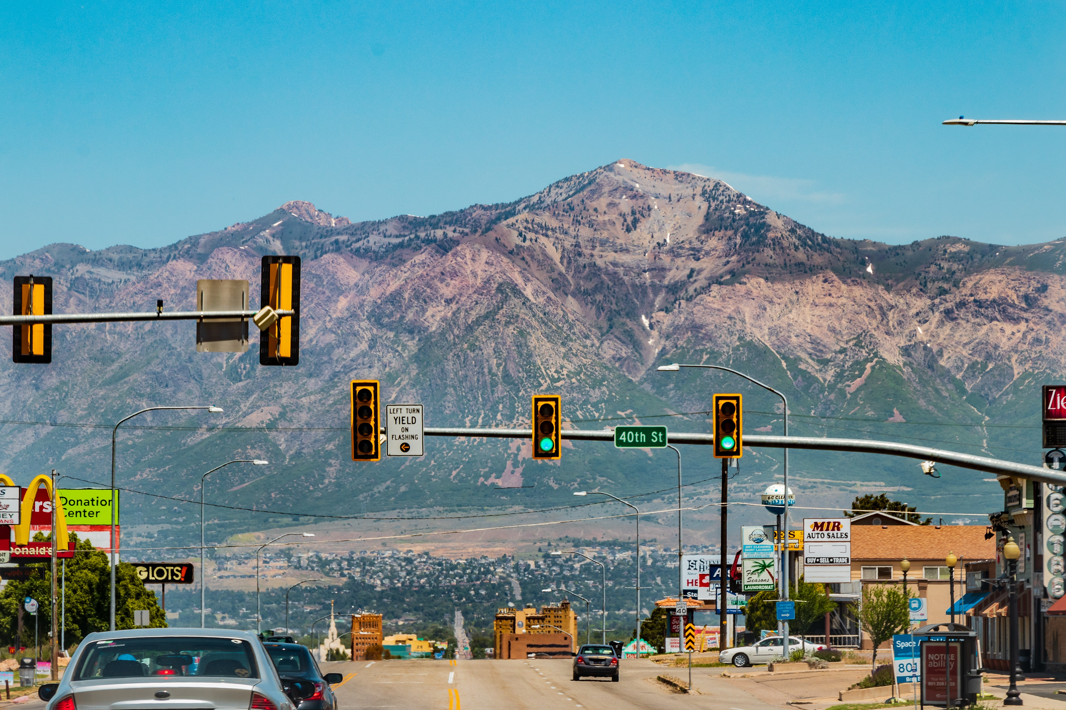
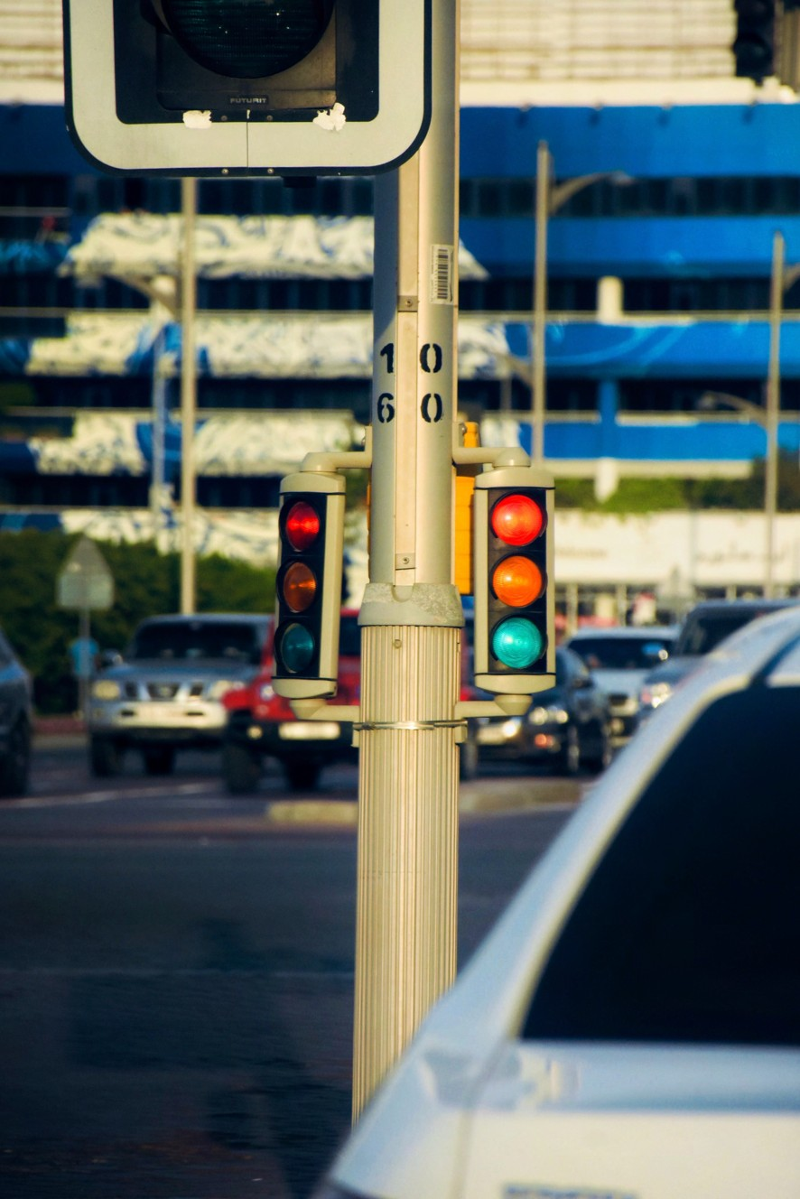
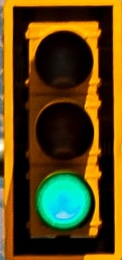

Why use HLP to benchmark?
People are very good on unstructured data tasks
Criteria: Can a human, given the same data, perform the task?

Slide 54
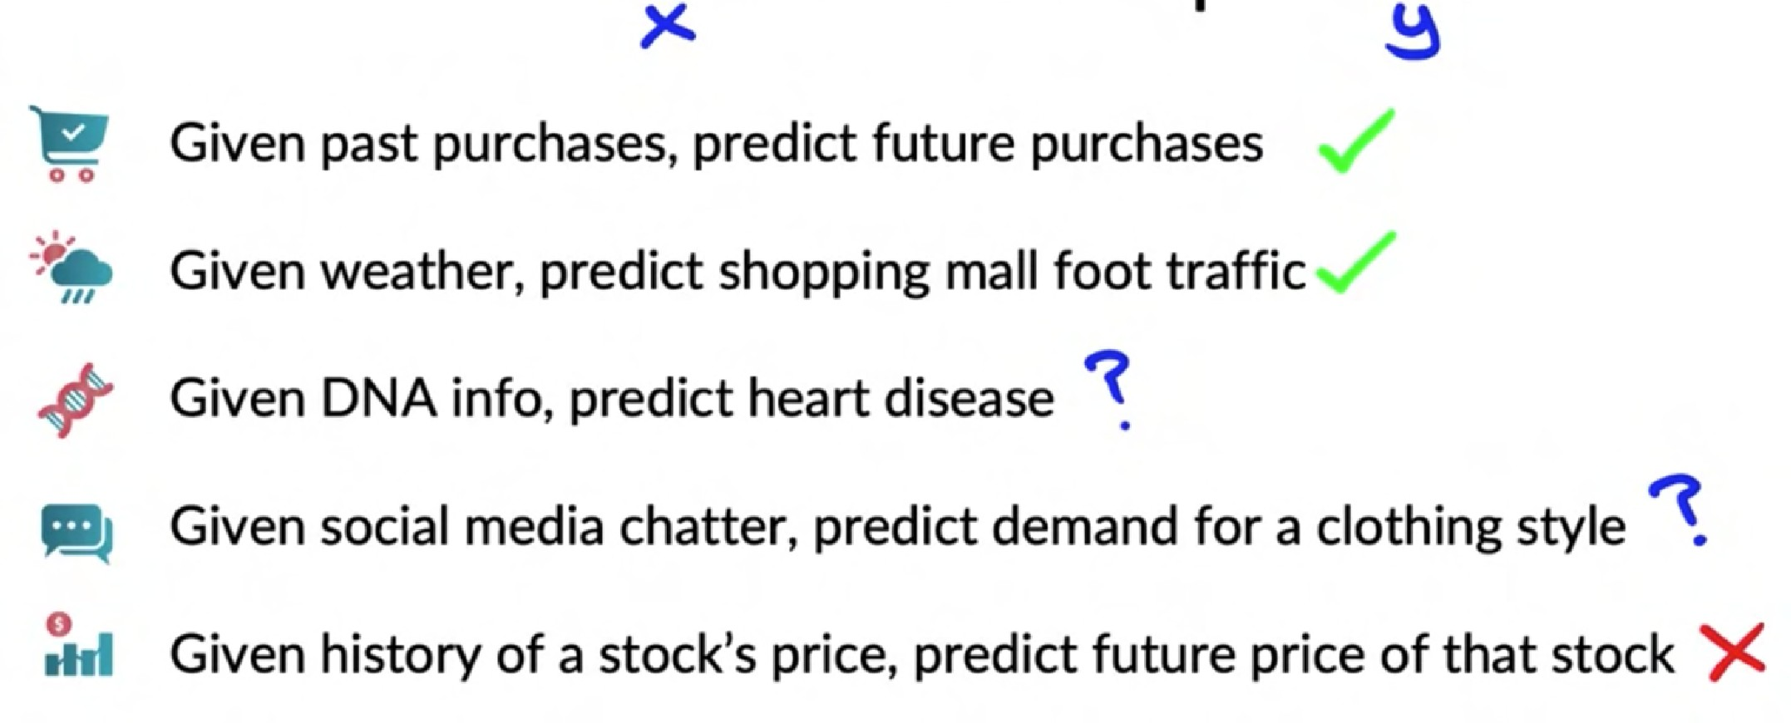




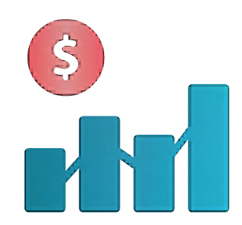
Do we have features that are predictive?
Given past purchases, predict future purchases
Given weather, predict shopping mall foot traffic Given DNA info, predict heart disease
Given social media chatter, predict demand for a clothing style Given stock price history, predict future price

Slide 55
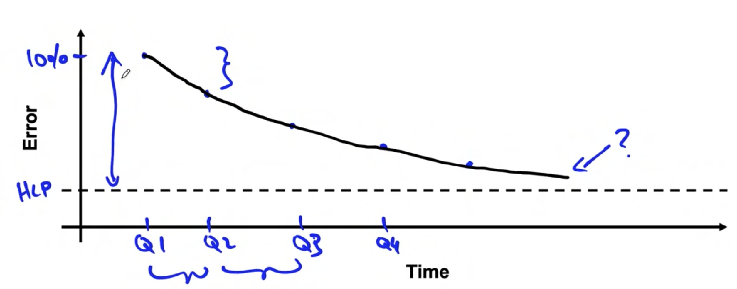
History of project
Error
Time

Slide 56
Scoping (optional)
Diligence on value

Slide 57
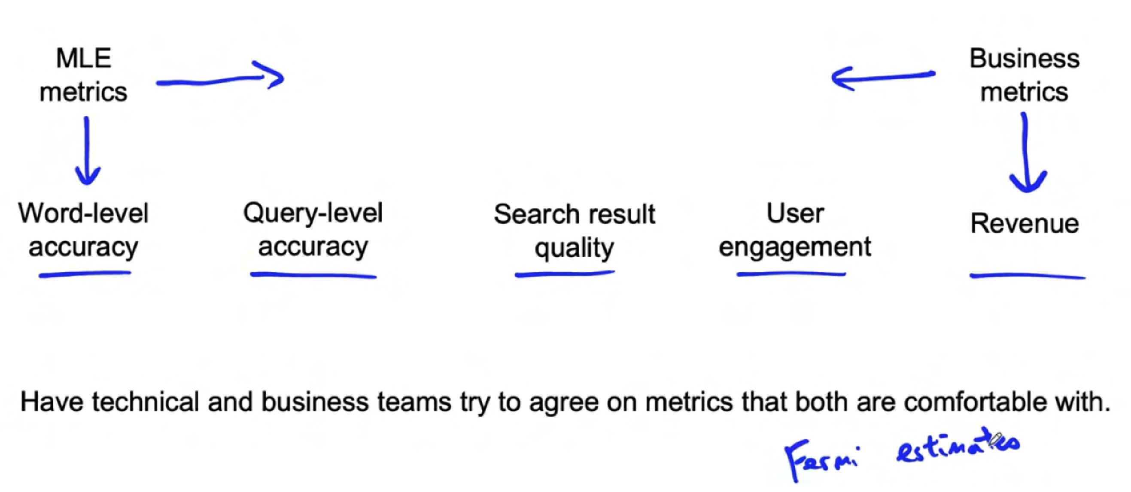
Diligence on value
MLE
metrics
Business metrics
Word-level accuracy
Query-level accuracy
Search result quality
User engagement
Revenue
Have technical and business teams try to agree on metrics that both are comfortable with.

Slide 58
Ethical considerations
! Is this project creating net positive societal value?
Is this project reasonably fair and free from bias?
Have any ethical concerns been openly aired and debated?

Slide 59
Scoping (optional)
Milestones and resourcing

Slide 60
Milestones
Key specifications:
ML metrics (accuracy, precision/recall, etc.)
Software metrics (latency, throughput, etc. given compute resources)
Business metrics (revenue, etc.)
Resources needed (data, personnel, help from other teams)
Timeline
If unsure, consider benchmarking to other projects, or building a POC (Proof of Concept) first.

